Slide 1

Time Series Forecasting and Modeling of Food Demand Supply Chain Using Regressor Analysis
CVR COLLEGE OF ENGINEERING (An UGC Autonomous Institute, Accredited by NAAC with ‘A’ Grade) Department of CSE B. Tech CSE-E III Year II Semester
Industrial Oriented Mini Project
Project Title:
PROJECT SUPERVISOR:
Dr. K. Venkatesh Sharma
Professor
Presented By:-
S.Durga – 23B81A05T0
V.Navya Reddy – 23B81A05U8

Slide 2
Abstract
Accurate food demand forecasting is crucial for meal delivery services because food is perishable and small prediction errors can cause losses. Existing platforms like Blue Yonder, SAP Integrated Business Planning, Oracle Demantra, and Infor Demand Management mainly use traditional statistical methods. These often fail to capture complex demand patterns, leading to overstocking or shortages.This study proposes a time series–based forecasting approach using machine learning and deep learning models. The dataset from Genpact includes weekly orders, pricing, promotions, and meal categories. Lag features and moving averages are used to model temporal patterns effectively. Random Forest, CatBoost, and LightGBM regression models were evaluated for food demand forecasting. Based on validation metrics, LightGBM demonstrated superior accuracy and stability compared to the other models. This improved predictive performance contributes to better inventory planning and supply chain optimization.

Slide 3
Introduction
Food demand forecasting is essential for efficient supply chain management in meal delivery services. Since food is perishable, inaccurate predictions can cause wastage, losses, and customer dissatisfaction. Traditional statistical models often fail to capture complex demand patterns.
FoodDemandAI is a machine learning–based forecasting system designed to predict weekly meal demand accurately. It uses historical order data, pricing, promotional details, and fulfillment center information to analyze trends and patterns. Advanced feature engineering techniques such as lag features and moving averages are used to model temporal dependencies.
The system compares models such as Random Forest, CatBoost, and LightGBM. Results show that LightGBM provides higher accuracy and stability, helping reduce wastage and improve supply chain decisions.

Slide 4
Literature Review:
S.No | Existing System | Description | Key Features | Limitations
1 | Blue Yonder | AI-based supply chain and demand forecasting platform | Demand planning, inventory optimization, AI-driven analytics | Expensive, complex implementation, limited customization for small businesses
2 | SAP IBP | Cloud-based integrated business planning solution | Real-time forecasting, scenario planning, supply chain integration | High cost, requires technical expertise, complex setup
3 | Oracle Demantra | Demand management and advanced forecasting tool | Statistical forecasting models, demand sensing, automated planning | Relies heavily on traditional models, less focus on deep learning
4 | Infor Demand Management | Predictive analytics platform for supply chain planning | Machine learning forecasting, demand collaboration tools | Limited flexibility, subscription cost high
5 | Traditional Statistical Models (ARIMA, MA) | Time series forecasting using historical data patterns | Simple implementation, interpretable results | Cannot capture complex nonlinear patterns, lower accuracy

Slide 5
Objectives
Accurate Demand Prediction
Reduction of Food Wastage
Prevention of Stockouts
Inventory Optimization
Cost Reduction & Profit Maximization
Data-Driven Decision Making
Seasonality & Trend Analysis
Scalable and Automated Forecasting System
Continuous Model Improvement Using Machine Learning

Slide 6
Existing Systems
Blue Yonder:
AI-driven supply chain and demand forecasting platform used by large enterprises.
Provides advanced analytics, inventory optimization, and automated planning.
Very expensive and complex to implement for small and medium businesses.
Requires high infrastructure and skilled professionals for maintenance.
SAP IBP:
Cloud-based integrated business planning solution for supply chains.
Supports real-time forecasting and scenario-based planning.
High implementation cost and complex configuration process.
Requires technical expertise and is less flexible for customized forecasting needs.

Slide 7
Problem Statement
The current food demand planning process in many meal delivery services relies on traditional statistical models or manual estimation techniques. While these methods provide basic forecasts, they often fail to capture complex temporal patterns, seasonal variations, and promotional impacts. This leads to overstocking, food wastage, stock shortages, and financial losses due to inaccurate demand predictions.
Existing enterprise solutions are expensive and complex, making them unsuitable for small and medium businesses. They often lack advanced deep learning capabilities to capture complex demand patterns. Therefore, a scalable forecasting system using machine learning and deep learning is needed for accurate and reliable demand prediction.
Problem Domain Knowledge :
Food Demand Forecasting falls under the domains of Time Series Analysis, Machine Learning, and Supply Chain Analytics. It involves analyzing historical order data, pricing, promotions, and categorical features to predict future demand. Accurate forecasting requires handling temporal dependencies, seasonality, and external influencing factors to ensure optimal inventory management and reduced food wastage.

Slide 8
Functional And Non-Functional Requirements:
Functional Requirements
Non-Functional Requirements
Data loading & preprocessing
Feature engineering (lag features, moving averages)
Model training (Random Forest, CatBoost, LightGBM)
Model evaluation (MAE, RMSE)
Weekly demand forecasting
Prediction accuracy
High performance
Scalability
Fast response time
Maintainability

Slide 9
Hardware & Software Requirements
Hardware Requirements:
Software Requirements:
Processor: Intel i5
RAM: 8 GB
Storage: 256 GB SSD
System Type: 64-bit system
Internet connection
Operating System: Windows
Programming Language: Python 3.x
IDE: Visual Studio Code (VS Code)
Machine Learning Framework: LightGBM
Libraries: NumPy, Pandas, Matplotlib, Scikit-learn
Version Control: Git

Slide 10
Proposed Methodology
The proposed system uses a time series–based machine learning and deep learning approach to predict weekly food demand.
Data Collection: Historical order, pricing, and promotion data are used.
Data Preprocessing: Missing values are handled and categorical features are encoded.
Feature Engineering: Lag features and moving averages are created to capture trends.
Model Building: Random Forest, CatBoost, and LightGBM models are trained.
Model Evaluation: Models are compared using MAE and RMSE.
Forecasting: The best model generates demand predictions for better inventory planning.

Slide 11
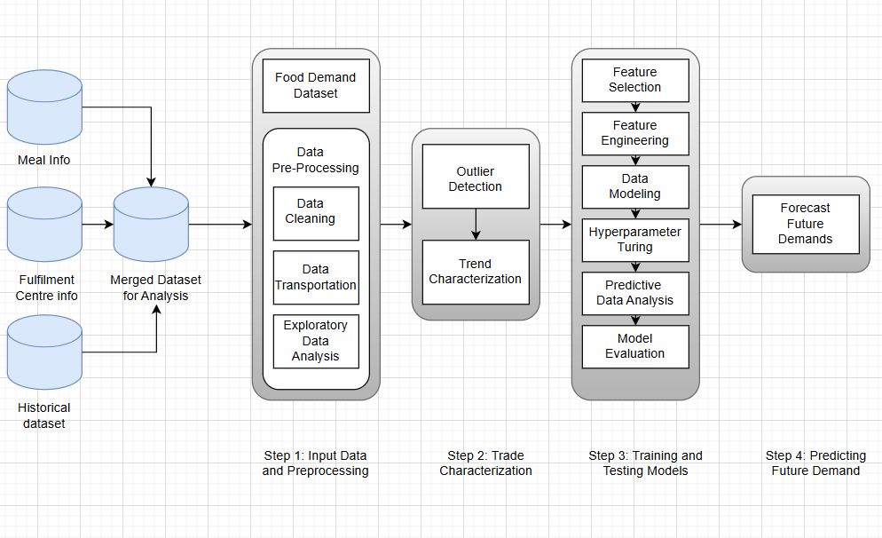
System Architecture

Slide 12
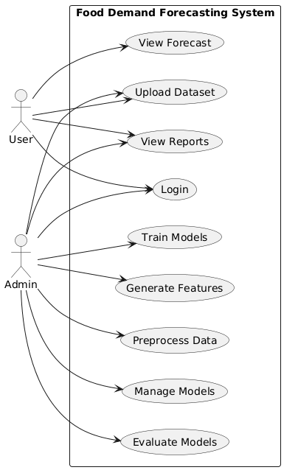
Use Case Diagram

Slide 13
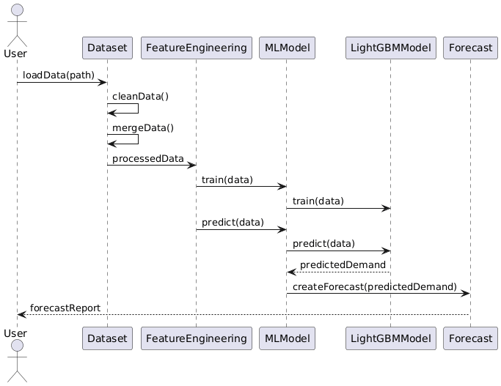
Sequence Diagram

Slide 14
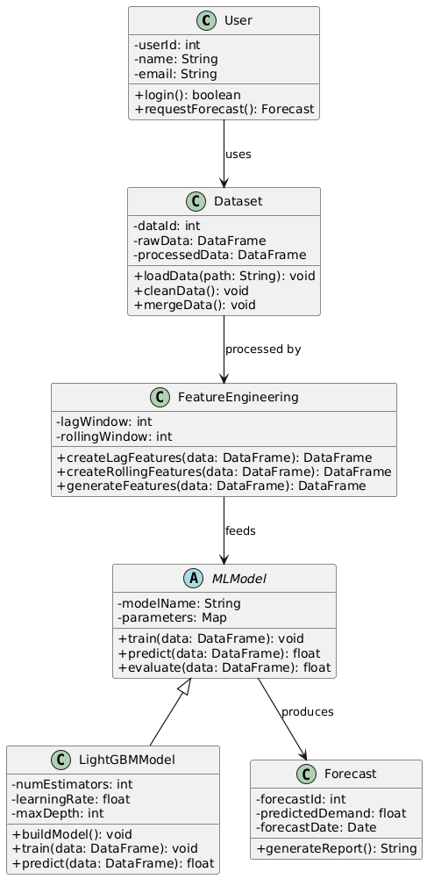
Class Diagram

Slide 15
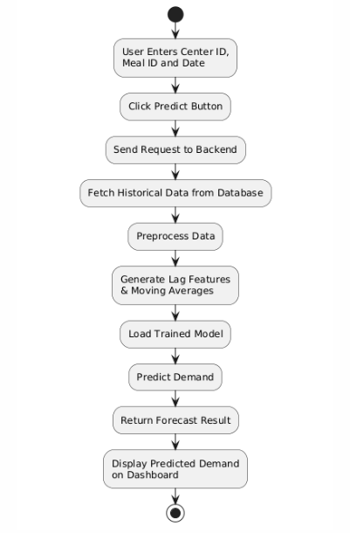
Activity Diagram

Slide 16
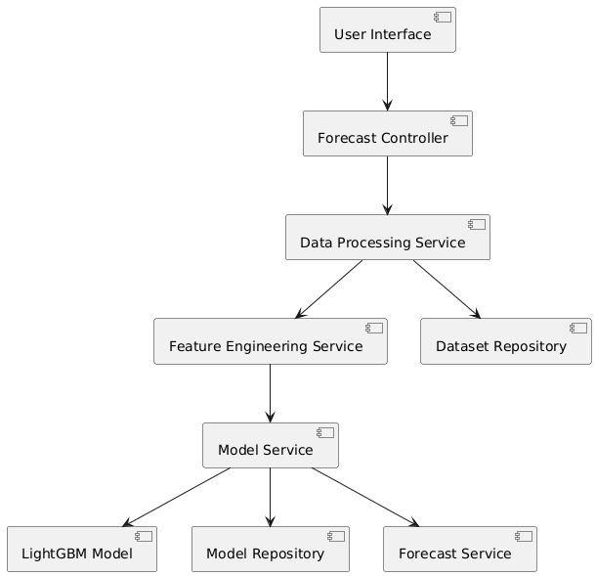
Component Diagram

Slide 17
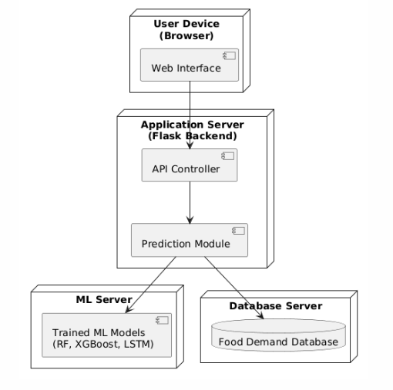
Deployment Diagram

Slide 18
References
[1] Kaggle, “Genpact – Food Demand Forecasting Competition.” [Online]. Available: https://www.kaggle.com/competitions/food-demand-forecasting Accessed: Mar. 1, 2026.
[2] Microsoft, “LightGBM Documentation.” [Online]. Available: https://lightgbm.readthedocs.io/. Accessed: Mar. 1, 2026.
[3] L. Prokhorenkova, G. Gusev, A. Vorobev, A. V. Dorogush, and A. Gulin, “CatBoost: Unbiased Boosting with Categorical Features,” Advances in Neural Information Processing Systems, vol. 31, 2018. [Online]. Available: https://arxiv.org/abs/1810.11363. Accessed: Mar. 1, 2026.
[4] Blue Yonder, “Demand Planning.” [Online]. Available: https://blueyonder.com/solutions/supply-chain-planning/demand-planning. Accessed: Mar. 1, 2026.
[5] Oracle Corporation, “Oracle Demantra Demand Management Overview.” [Online]. Available: https://docs.oracle.com/cd/E18727_01/doc.121/e05179/T493571T493575.htm. Accessed: Mar. 1, 2026.

Slide 19
Future Course of Action
Improve model accuracy by adding more historical and external data.
Deploy the system as a cloud-based web application.
Add real-time demand prediction features.
Develop a better dashboard for visualization and reports.
Expand the system to support multiple cities and fulfillment centers.

Slide 20
THANK YOU

